Slide 1
MGS 723: Geodynamics
Class 11: Heat Transfer I
Mixed sources for today, but derivations from: Turcotte & Schubert, 2nd Ed., Sect. 4

Slide 2
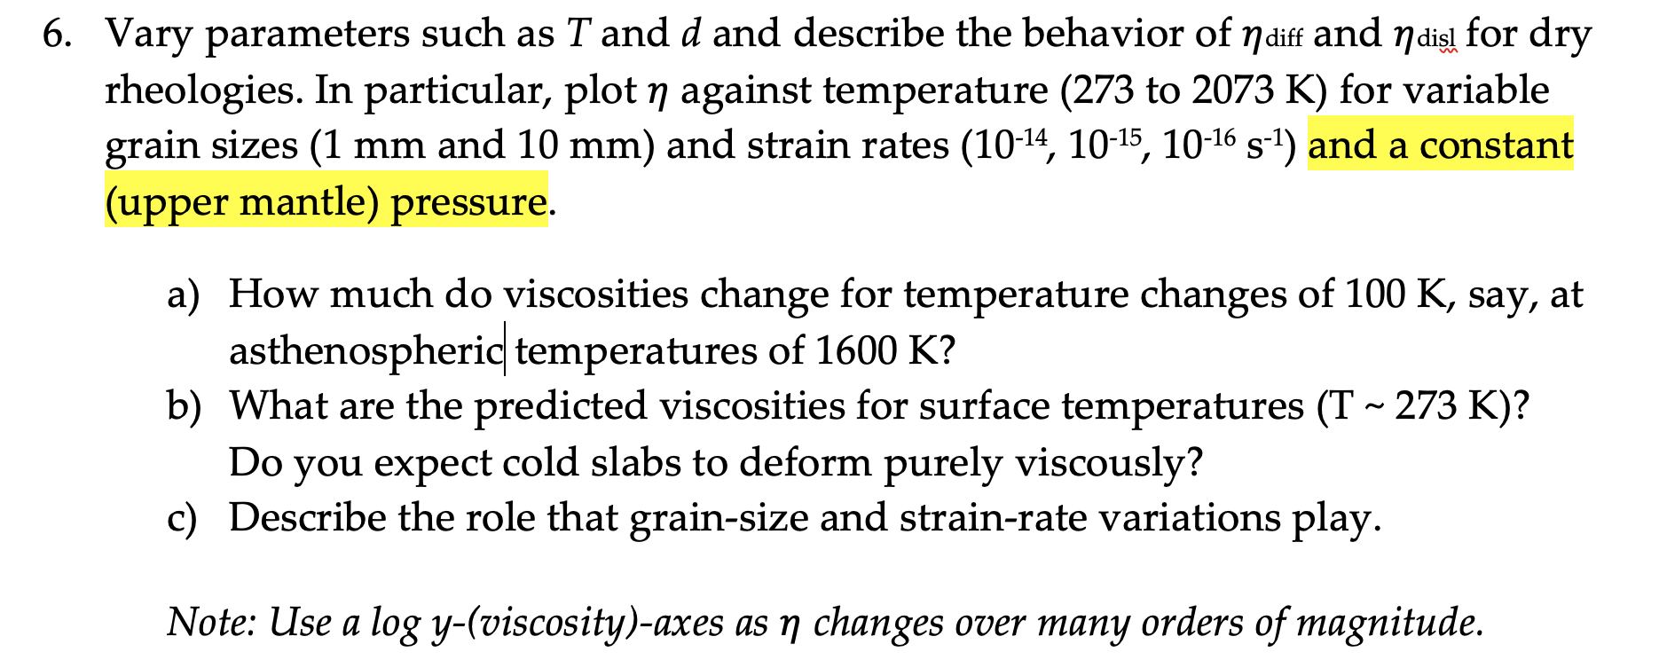

Problem set #2 clarifications
Clarification I:
Clarification II: (example Python plot script on Box)

Slide 3
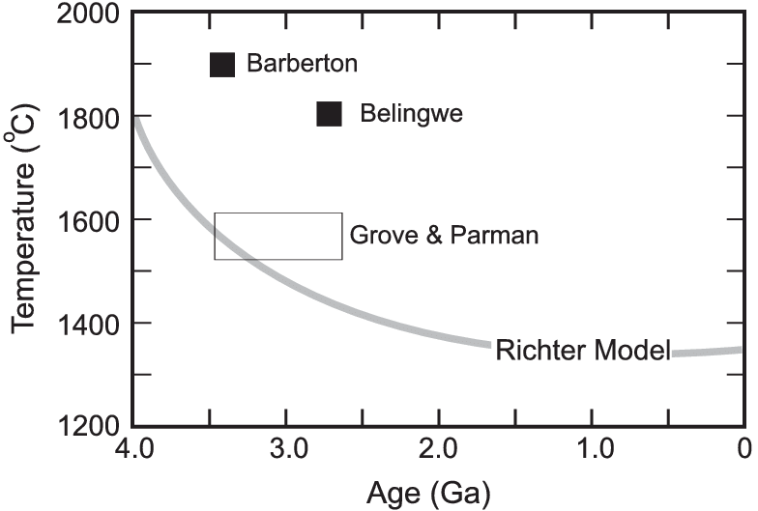
Secular cooling of Earth
Mantle temperature
Komatiites
Notes:
The fact that the temperature of the earth increases with the depth below the surface, implies a continual loss of heat from the interior by conduction outwards, through or into the upper crust. Since the upper crust does not become hotter from year to year, there must therefore be a secular loss of heat from the whole earth. It is possible that no cooling may result from this loss of heat, but only exhaustion of potential energy, which in this case could scarcely be other than chemical affinity between substances forming part of the earth's mass. But it is certain that either the earth is becoming, on the whole, cooler from age to age, or that the heat conducted out is generated in the interior by temporary dynamical action (such as chemical combination).
Main paper: https://www.researchgate.net/publication/266390574_Komatiites/figures?lo=1&utm_source=google&utm_medium=organic
Grove TL, Parman SW.. Thermal evolution of the Earth as recorded by komatiites. Earth Planet Sci Lett 219: 173-187

Slide 4
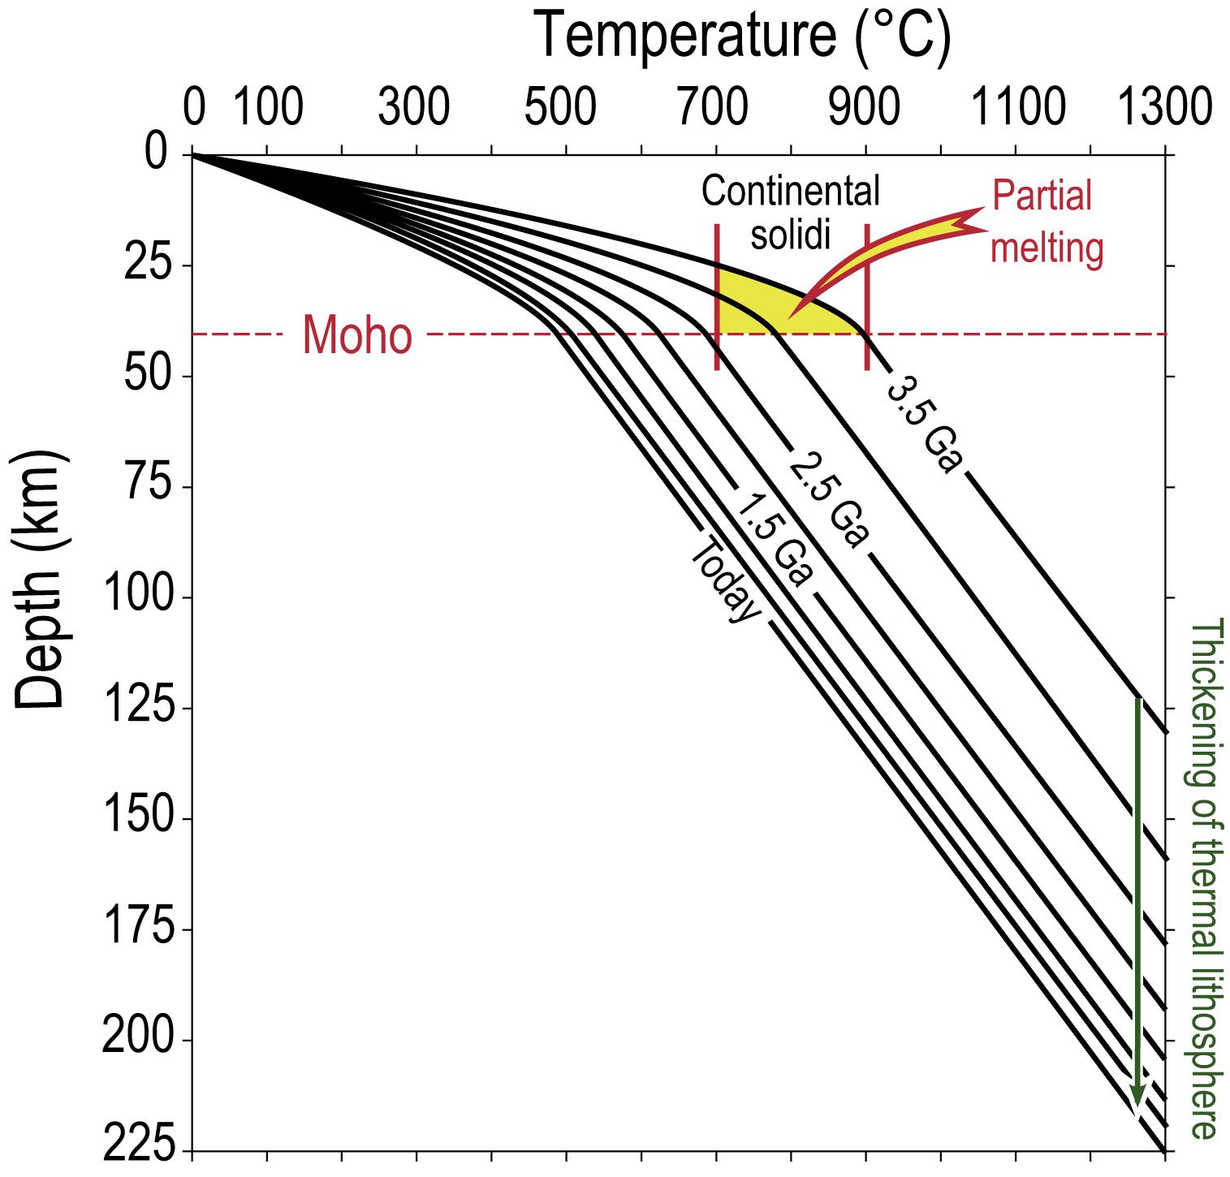
Secular cooling of Earth
Mantle temperature
Thermal evolution of an Archaean craton (Vanderhaege et al., 2019)

Slide 5
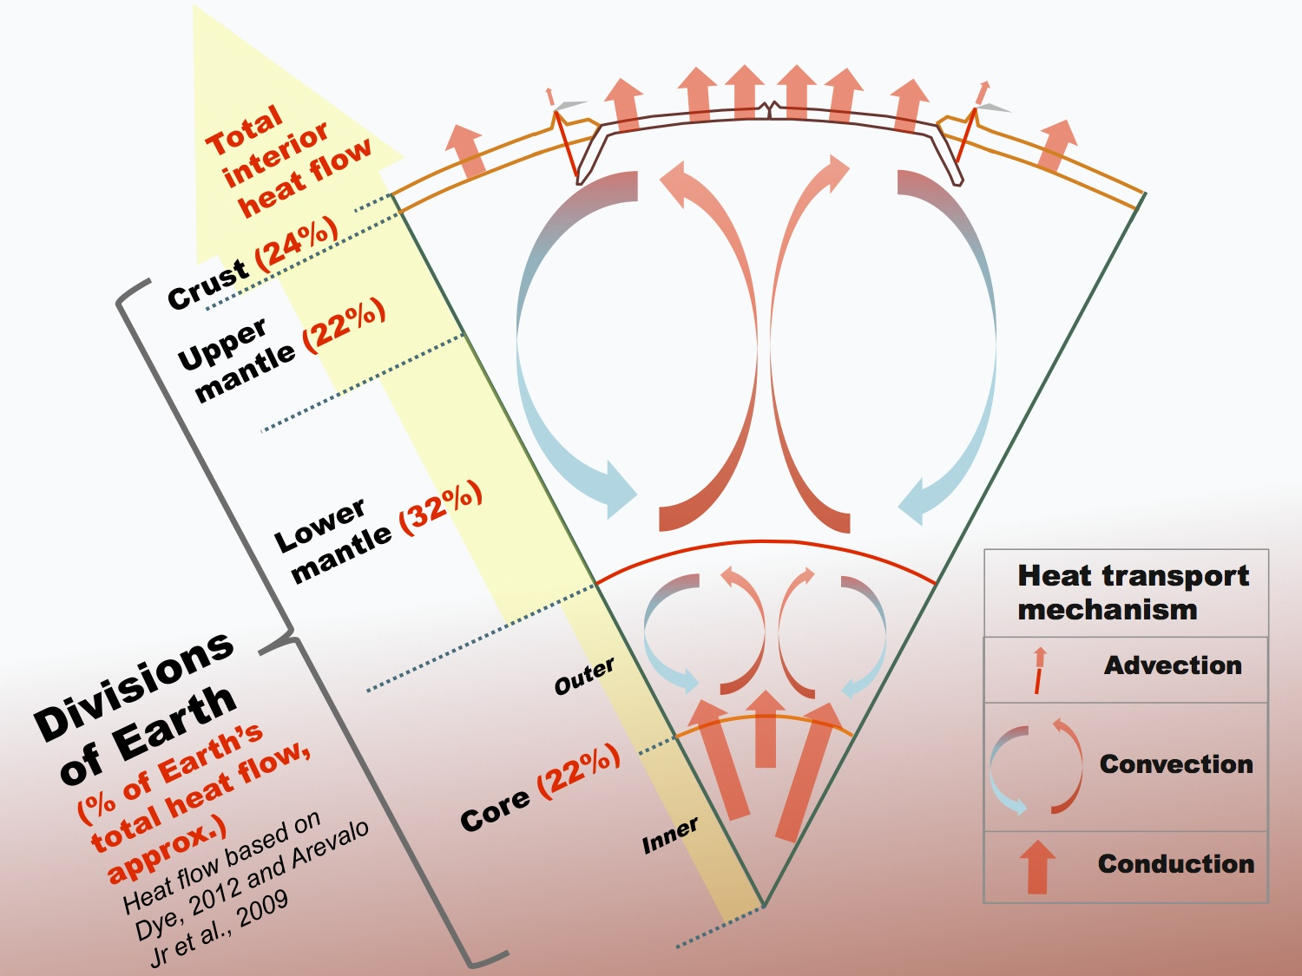
~ 45 TW
Two main mechanisms for this heat to escape the core
Notes:
Cross-section of the Earth showing its main divisions and their approximate contributions to Earth's total internal heat flow to the surface, and the dominant heat transport mechanisms within the Earth. Percentages based on review in (1) Dye, S. T. (2012). Geoneutrinos and the radioactive power of the Earth. Reviews of Geophysics, 50(3), and (2) Arevalo Jr, R., McDonough, W. F., & Luong, M. (2009). The K/U ratio of the silicate Earth: Insights into mantle composition, structure and thermal evolution. Earth and Planetary Science Letters, 278(3), 361–369.

Slide 6
~ 45 TW
Two main mechanisms for this heat to escape the core
Where does this heat come from?
Notes:
Cross-section of the Earth showing its main divisions and their approximate contributions to Earth's total internal heat flow to the surface, and the dominant heat transport mechanisms within the Earth. Percentages based on review in (1) Dye, S. T. (2012). Geoneutrinos and the radioactive power of the Earth. Reviews of Geophysics, 50(3), and (2) Arevalo Jr, R., McDonough, W. F., & Luong, M. (2009). The K/U ratio of the silicate Earth: Insights into mantle composition, structure and thermal evolution. Earth and Planetary Science Letters, 278(3), 361–369.

Slide 7
~ 45 TW
Two main mechanisms for this heat to escape the core
Where does this heat come from?
Radioactive decay (U, Th, K), ~50%
Primordial heat, ~50%
Notes:
Cross-section of the Earth showing its main divisions and their approximate contributions to Earth's total internal heat flow to the surface, and the dominant heat transport mechanisms within the Earth. Percentages based on review in (1) Dye, S. T. (2012). Geoneutrinos and the radioactive power of the Earth. Reviews of Geophysics, 50(3), and (2) Arevalo Jr, R., McDonough, W. F., & Luong, M. (2009). The K/U ratio of the silicate Earth: Insights into mantle composition, structure and thermal evolution. Earth and Planetary Science Letters, 278(3), 361–369.

Slide 8
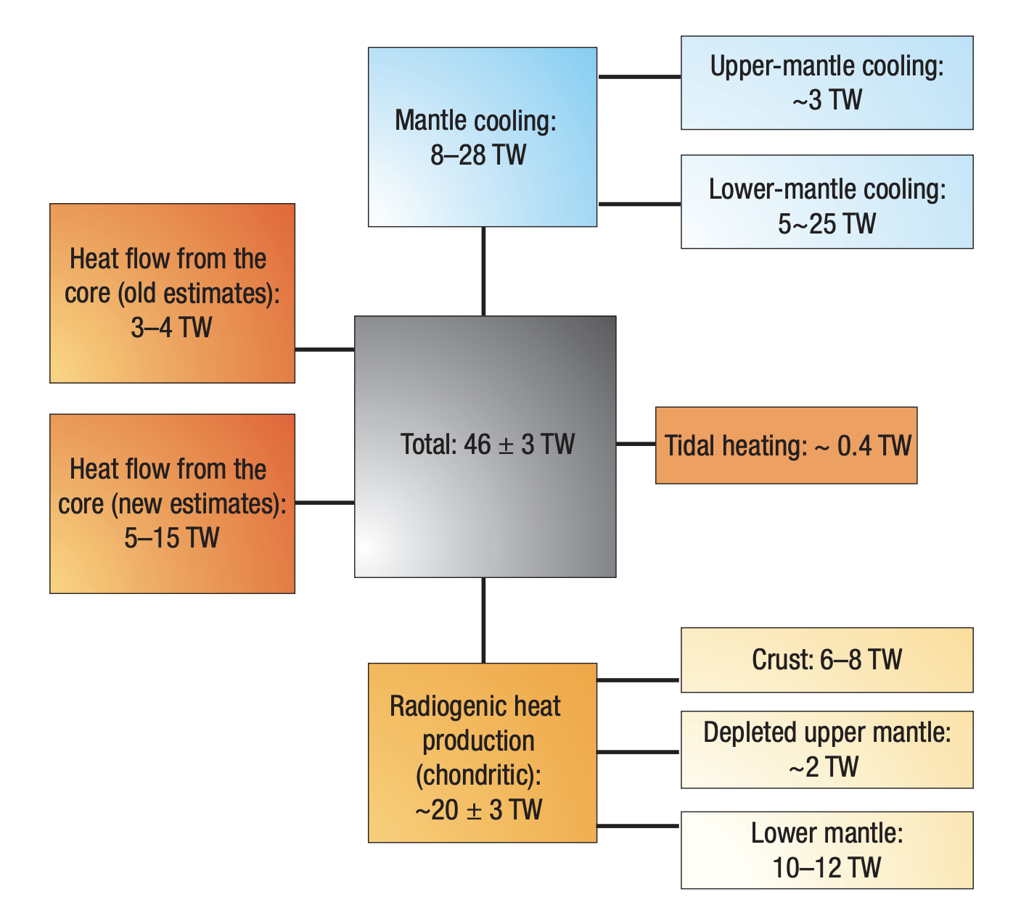
Earth’s heat budget
Significant uncertainty in many of these heat fluxes
Lay et al., 2008, Nature

Slide 9
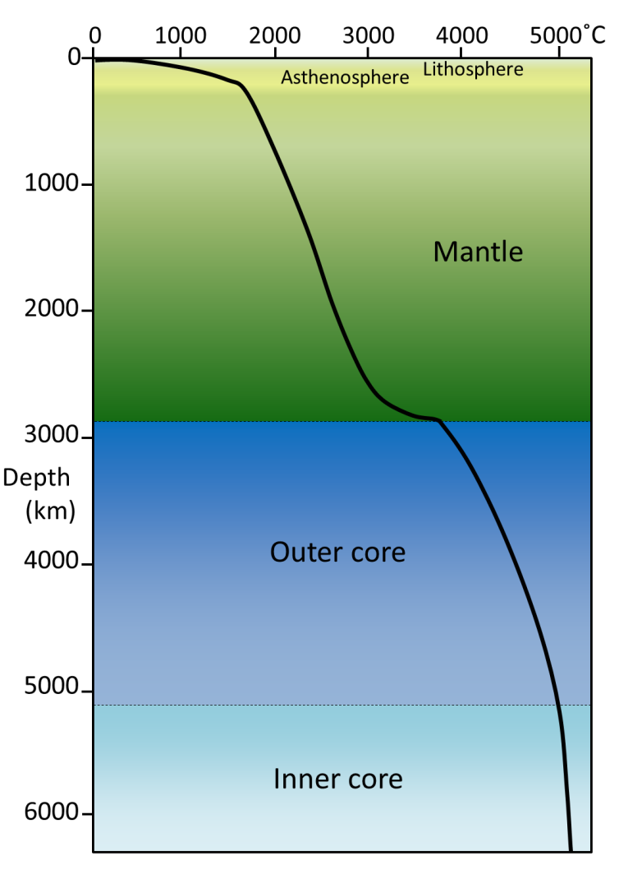
The Geotherm

Slide 10
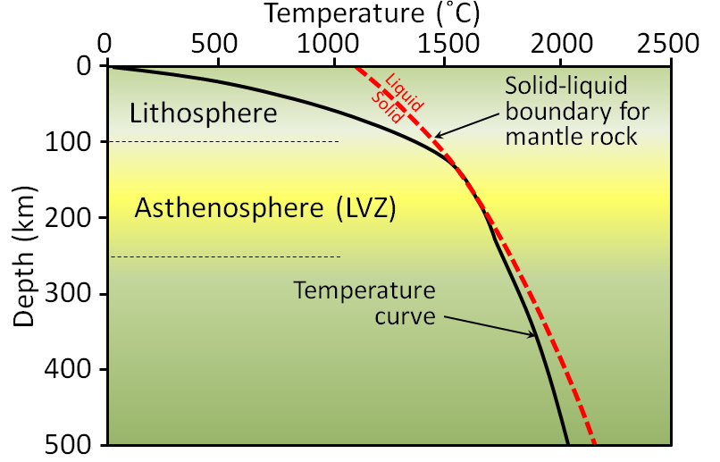
The Geotherm

Slide 11
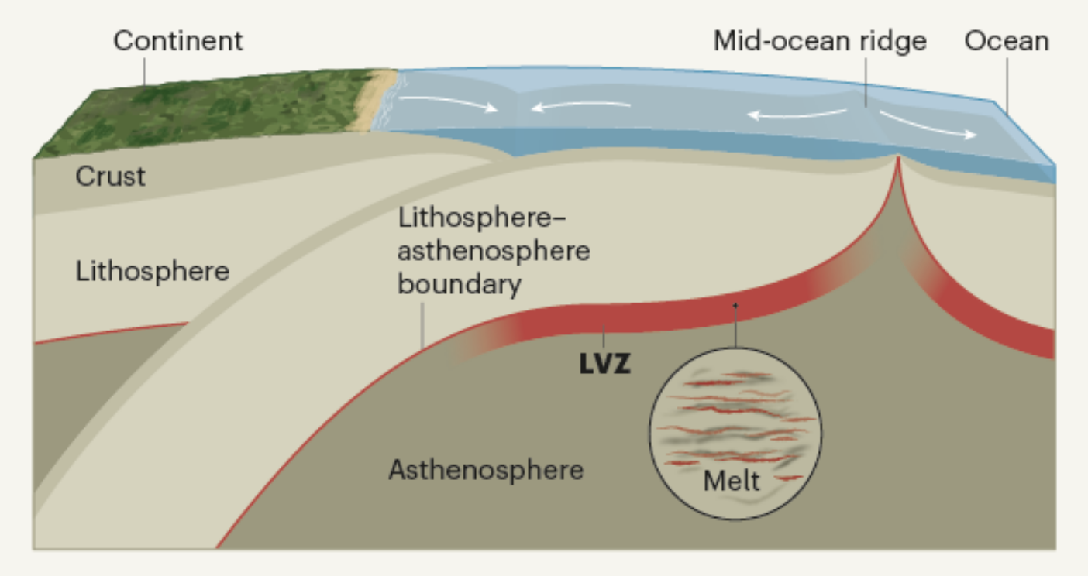
Cobden, 2020

Slide 12
Heat transfer basics
Heat is a form of energy [J = Joules]
Energy per unit time is power [J/s = Watts = W]
Across Earth boundaries (e.g., the surface), we often talk about heat flux. This is power/unit area [W/m²]

Slide 13
Heat transfer basics
Heat is a form of energy [J = Joules]
Energy per unit time is power [J/s = Watts = W]
Across Earth boundaries (e.g., the surface), we often talk about heat flux. This is power/unit area [W/m²]
On Earth:
At surface: Incoming radiated solar heat flux ~ 400 W/m²
At surface: Outgoing heat flux (i.e., from solid Earth) ~ 90 mWm²
Produces total heat flux (power) of ~ 45 TW
Note: incoming solar heat of minimal relevance to solid Earth processes
Notes:
About 3 percent of the energy that strikes the ground is reflected back into the atmosphere. The rest is absorbed by rocks, soil, and water and then radiated back into the air as heat. These infrared wavelengths can only be seen by infrared sensors. Because solar energy continually enters Earth’s atmosphere and ground surface, is the planet getting hotter? The answer is no (although the next section contains an exception) because energy from Earth escapes into space through the top of the atmosphere. If the amount that exits is equal to the amount that comes in, then average global temperature stays the same. This means that the planet’s heat budget is in balance. What happens if more energy comes in than goes out? If more energy goes out than comes in?

Slide 14
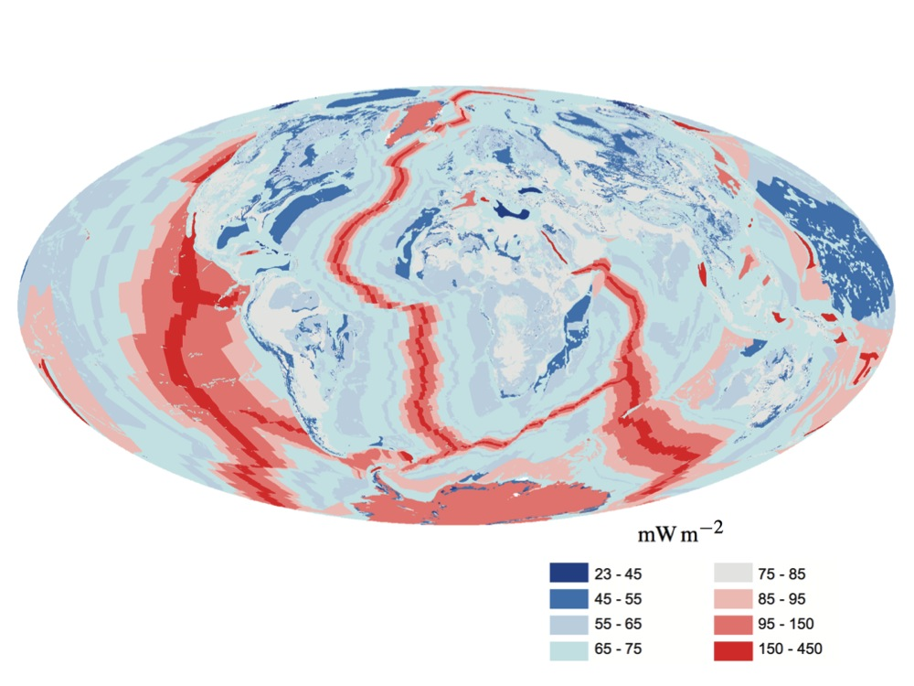
Surface heat flux ~ 45 TW
Davies and Davies, 2010

Slide 15
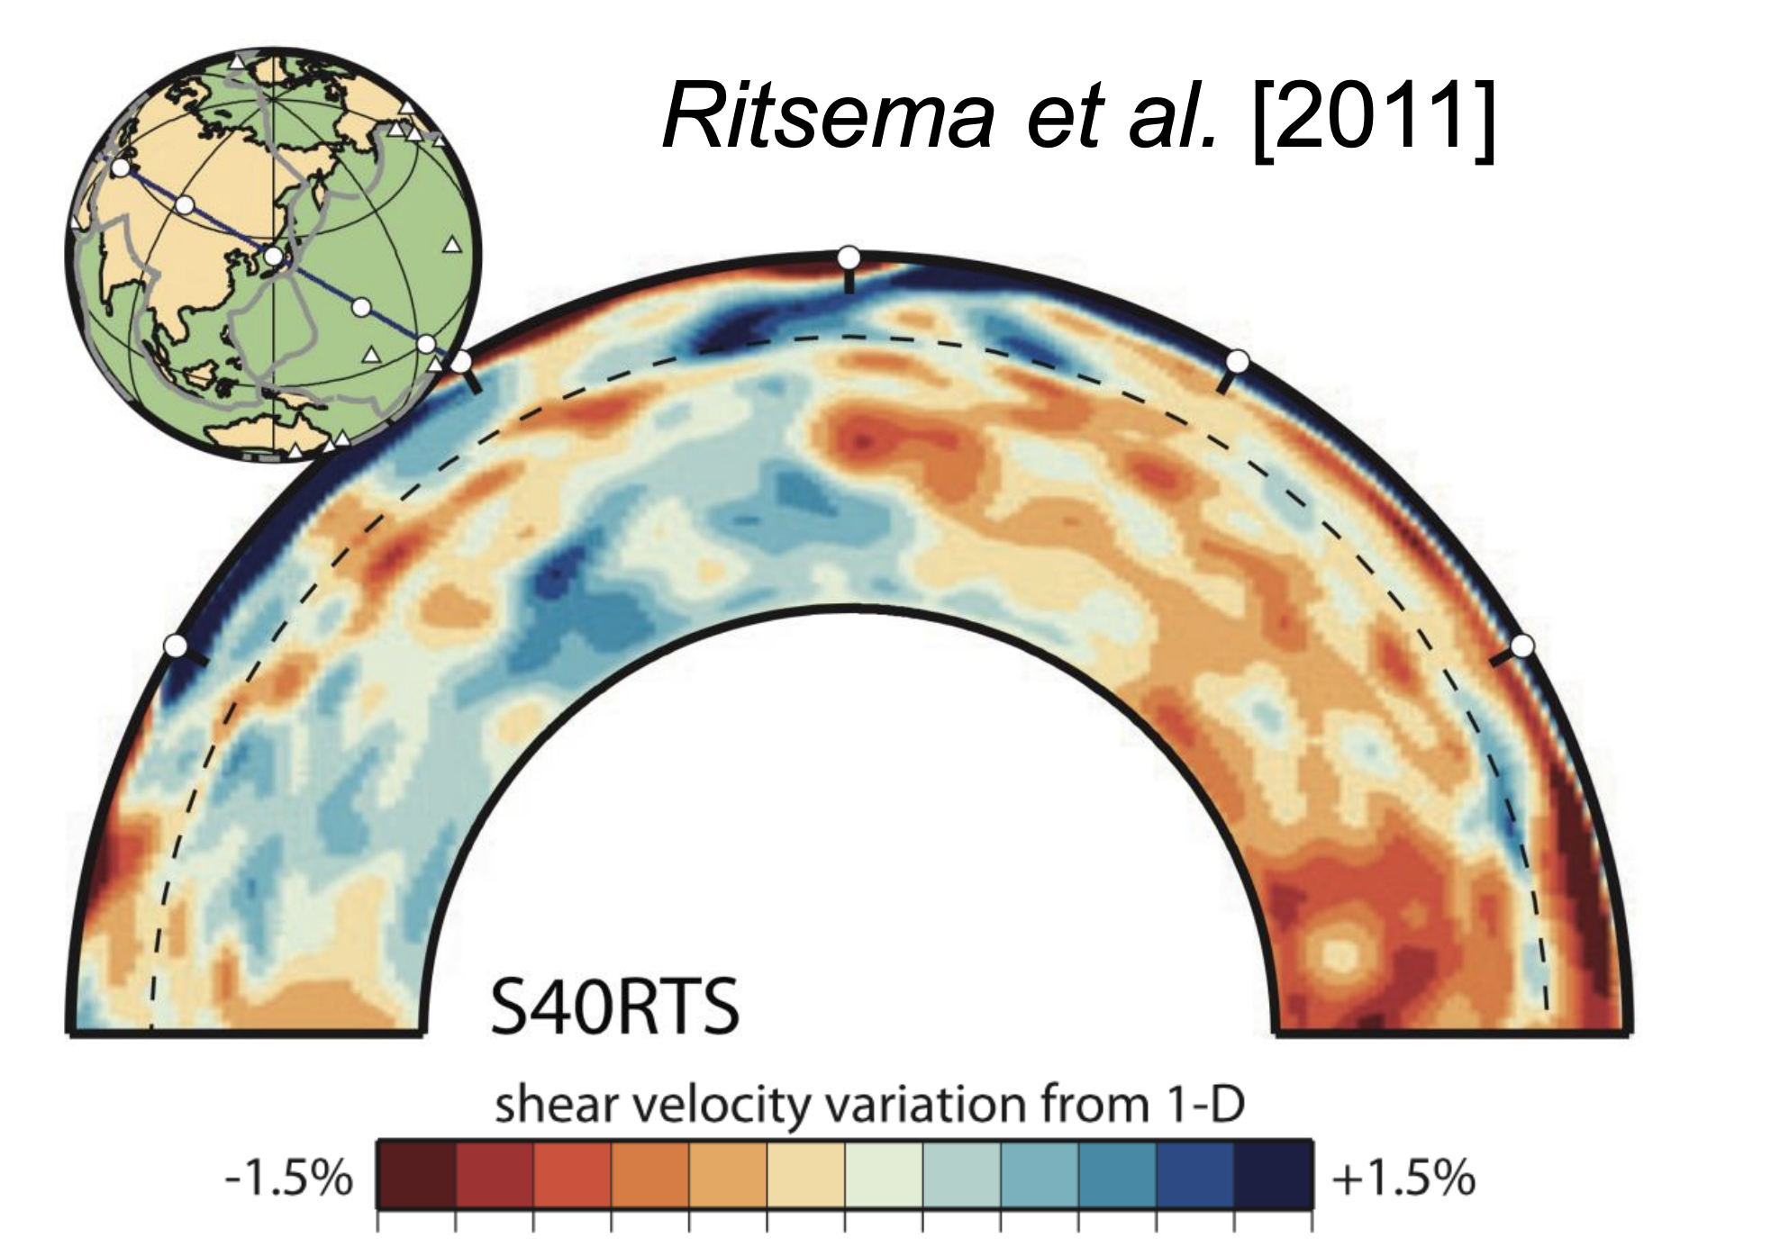

The fundamental driver for solid Earth structure

Slide 16
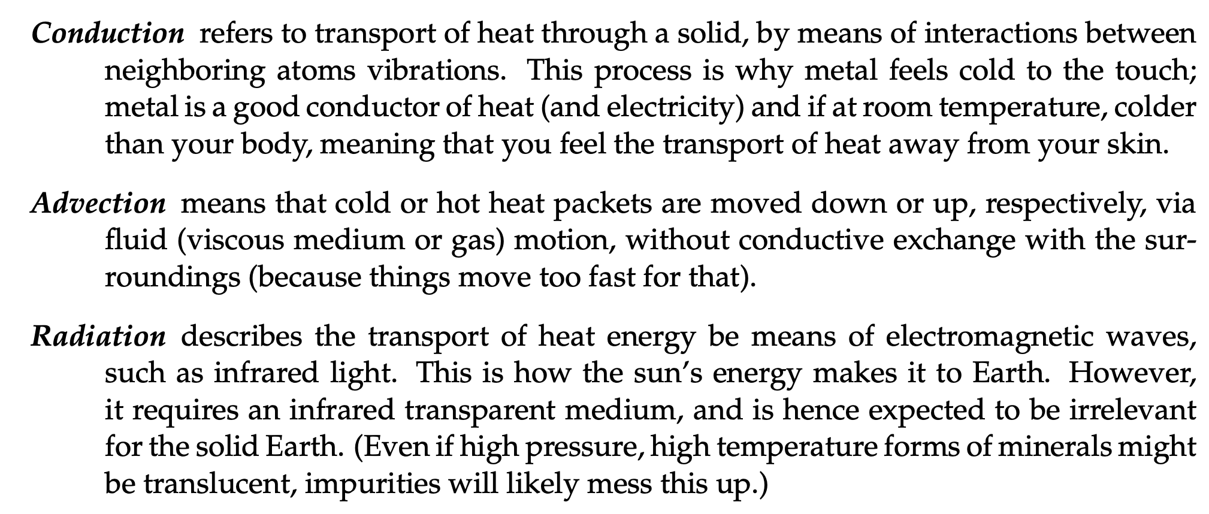
3 types of heat transfer
Becker and Faccenna

Slide 17

3 types of heat transfer
Becker and Faccenna

Slide 18
3 types of heat transfer
When these two modes of heat transfer work together:
Becker and Faccenna
Notes:
Temporal evolution of plume generation during third phase by andesite at the bottom boundary layer and dacite at the top boundary layer for simulation #1. The boundary layers become thinner with time.

Slide 19
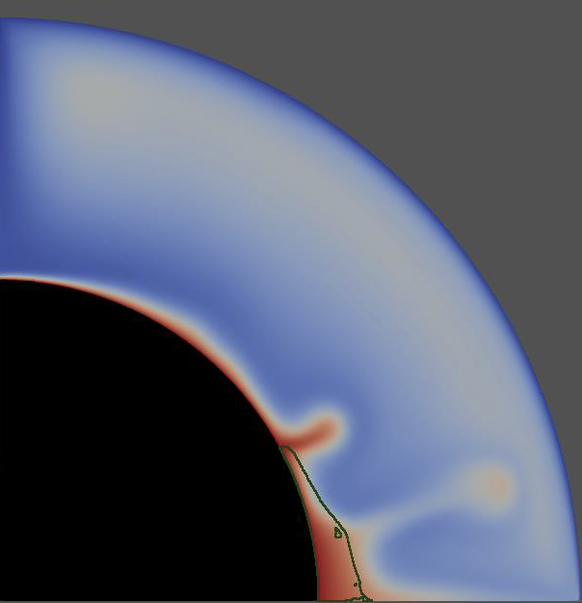
3 types of heat transfer
When these two modes of heat transfer work together:
Convection
Heyn et al., 2018
Notes:
Temporal evolution of plume generation during third phase by andesite at the bottom boundary layer and dacite at the top boundary layer for simulation #1. The boundary layers become thinner with time.

Slide 20

To the stylus…
To: Derive conduction equation in 1-D and 3-D; Apply to Earth to derive idealized geotherms

Slide 21
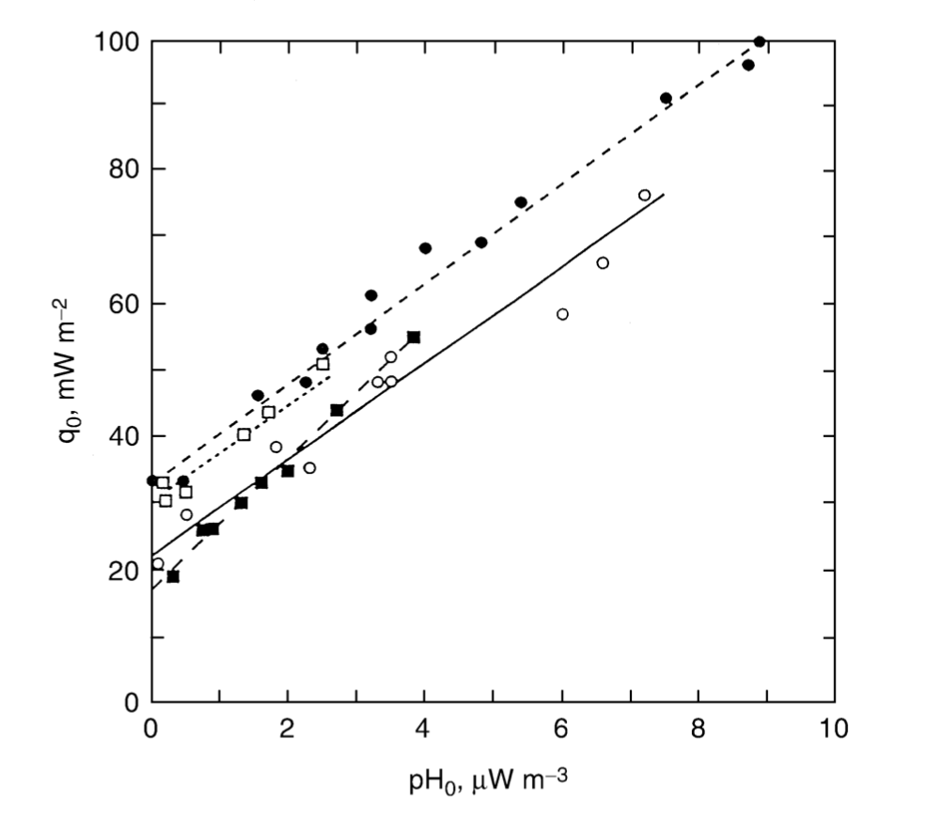
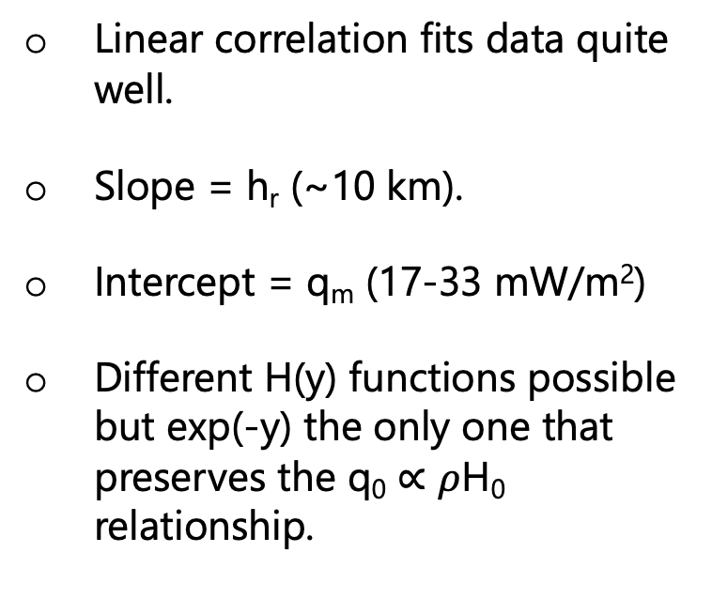
Continental geotherms
Linear correlation fits data quite well.
Slope = h_{r} (~10 km).
Intercept = q_{m} (17-33 mW/m²)
Different H(y) functions possible but exp(-y) the only one that preserves the q₀ $∝$ $ρ$H₀ relationship.
Solid squares = Sierra Nevada; solid circles = Eastern US; open circles = Norway and Sweden; open squares = Canadian Shield
Figure 4-11: T&S

Slide 22
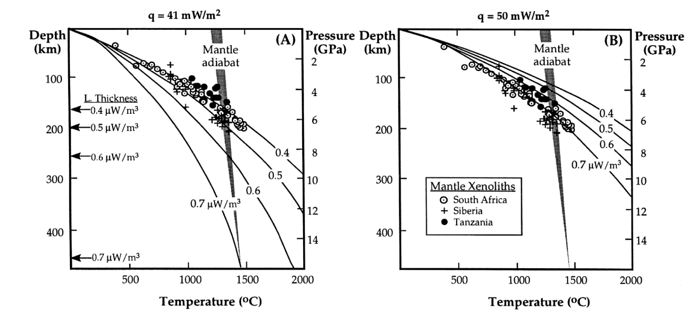
Continental geotherms
Notes:
Dunite is olivine-rich peridotite

Slide 23
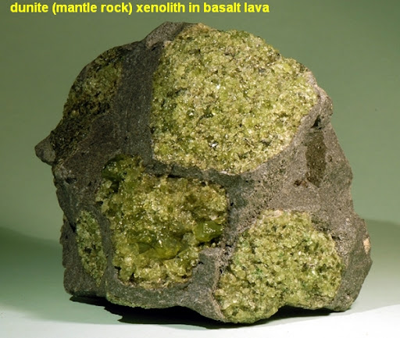
Continental geotherms
Notes:
Dunite is olivine-rich peridotite

Slide 24
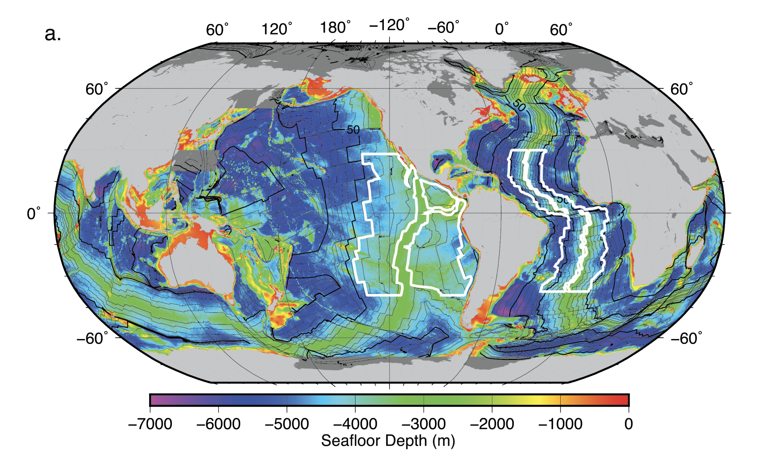
Next session: Cooling of oceanic plates
C.E. Watkins, 2016

Slide 25
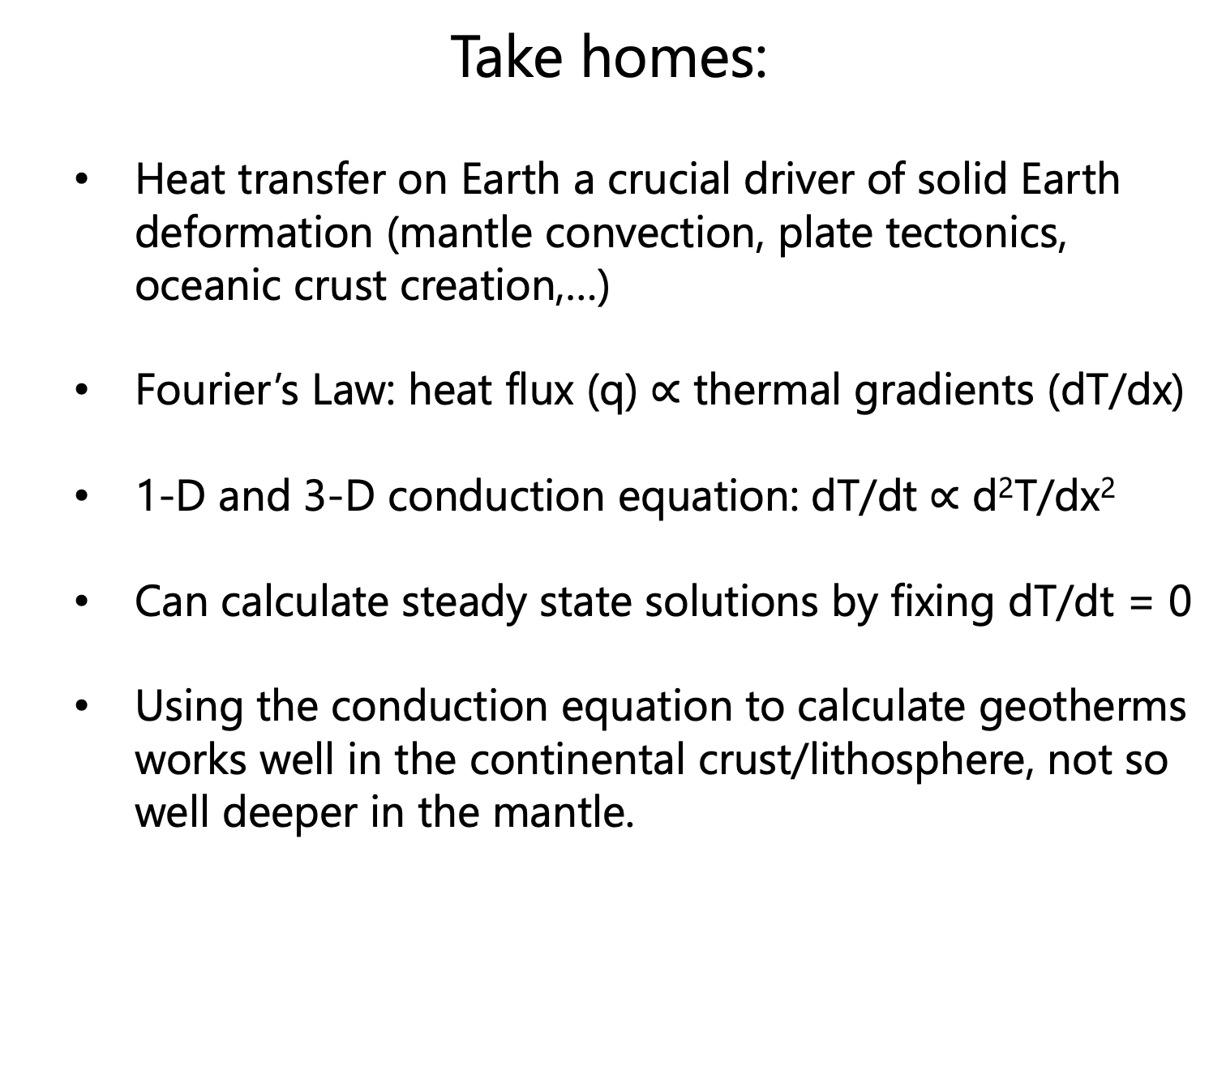
Take homes:
Heat transfer on Earth a crucial driver of solid Earth deformation (mantle convection, plate tectonics, oceanic crust creation,…)
Fourier’s Law: heat flux (q) $∝$ thermal gradients (dT/dx)
1-D and 3-D conduction equation: dT/dt $∝$ d²T/dx²
Can calculate steady state solutions by fixing dT/dt = 0
Using the conduction equation to calculate geotherms works well in the continental crust/lithosphere, not so well deeper in the mantle.

